Slide 1
Discussion 0: Introduction
Section 138L/136
CS61A Spring 2019

Slide 2
Welcome to CS61A!
GSI: Jason Zhou
Section 138L/136: Wed/Fri @ 12:30 AM - 2:00 PM @ Soda 277/320
Contact
jasonzhou@berkeley.edu w/ [Section 136] in title
Piazza private post w/ [Section 136] in title
Resources
cs61a.org: Past Exams, Guides, etc.
jasonxzhou.com/teaching
Office Hours
CS61A: TBD ASAP
Eta Kappa Nu (hkn.mu): TBD in ~2 weeks

Slide 3
Anonymous Feedback
links.cs61a.org/jasonz-feedback

Slide 4
Announcements
Wednesday 1/30: Lab01
Friday 2/01: Lab00 Due

Slide 5
Agenda
Lost on the Moon
61A Grading Policies, Tips, Strategies
Q & A

Slide 6
Lost on the Moon

Slide 7
Lost on the Moon
1 | Two 100-pound tanks of oxygen
2 | 5 gallons of water
3 | Stellar map
4 | Food concentrate
5 | Solar-powered FM receiver-transmitter

Slide 8
Lost on the Moon
6 | 50 feet of nylon rope
7 | First-aid kit
8 | Parachute silk
9 | Self-inflating life raft
10 | Signal Flares

Slide 9
Lost on the Moon
11 | Two .45 caliber pistols
12 | One case of dehydrated milk
13 | Solar-powered portable heating unit
14 | Magnetic compass
15 | Box of matches

Slide 10
Lost on the Moon
0 - 25 | Excellent
26 - 32 | Good
33 - 55 | Fair
56 - 70 | Oh well
71 - 112 | Oops

Slide 11
Lost on the Moon
Team >> Individual
Collaborative environment
Making new friends/potential project partners for 61A

Slide 12
61A Tips & Strats
Use Piazza for everything
Best way to contact course staff
Pooled coursewide resource for ~1k people
Fast response time
Manage your time well
Stay caught up on lectures
Start projects early
Plan ahead for office hours
Struggle through practice midterms
Exam problems significantly more challenging than most lab/hw/dis problems
Print out past midterms, work through them on paper by hand
Go for quantity at first; digest and understand many exam-level problems
Ask questions

Slide 13
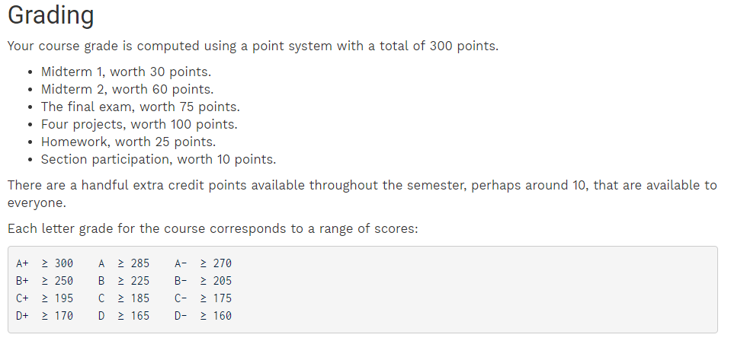

Slide 14
Q & A
Research?
Logistics/Policy?
61A Content?
Exams?
EE/CS Course Selection?

Slide 15
Attendance
links.cs61a.org/jasonz-attendance

